Slide 1
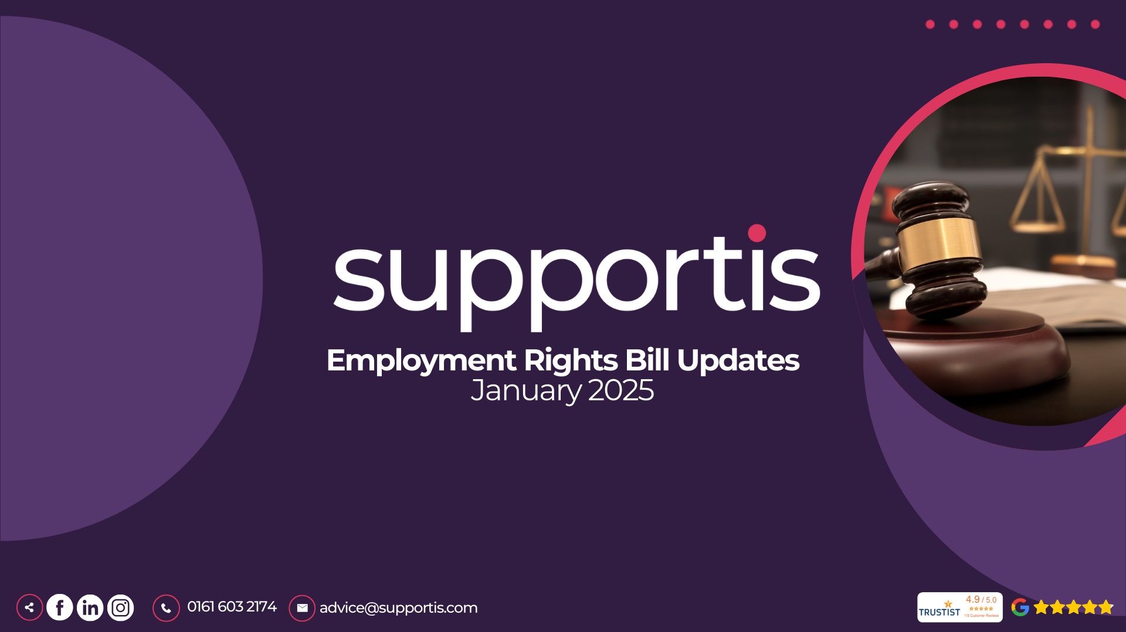
Notes:
Employment law is constantly changing, and it's vital that we, as managers, stay up-to-date. This session, provided by Supportis, our trusted HR and Employment Law advisors, will equip you with the knowledge you need to confidently manage your teams in accordance with the latest legislation. We'll cover important updates on topics ranging from family-friendly rights and pay regulations to workplace conduct and whistleblowing. This training is designed to equip you with the practical skills and understanding necessary for compliant and effective people management. Supportis works with us to ensure our HR and Employment Law practices are compliant and that our managers are informed of any upcoming changes.

Slide 2
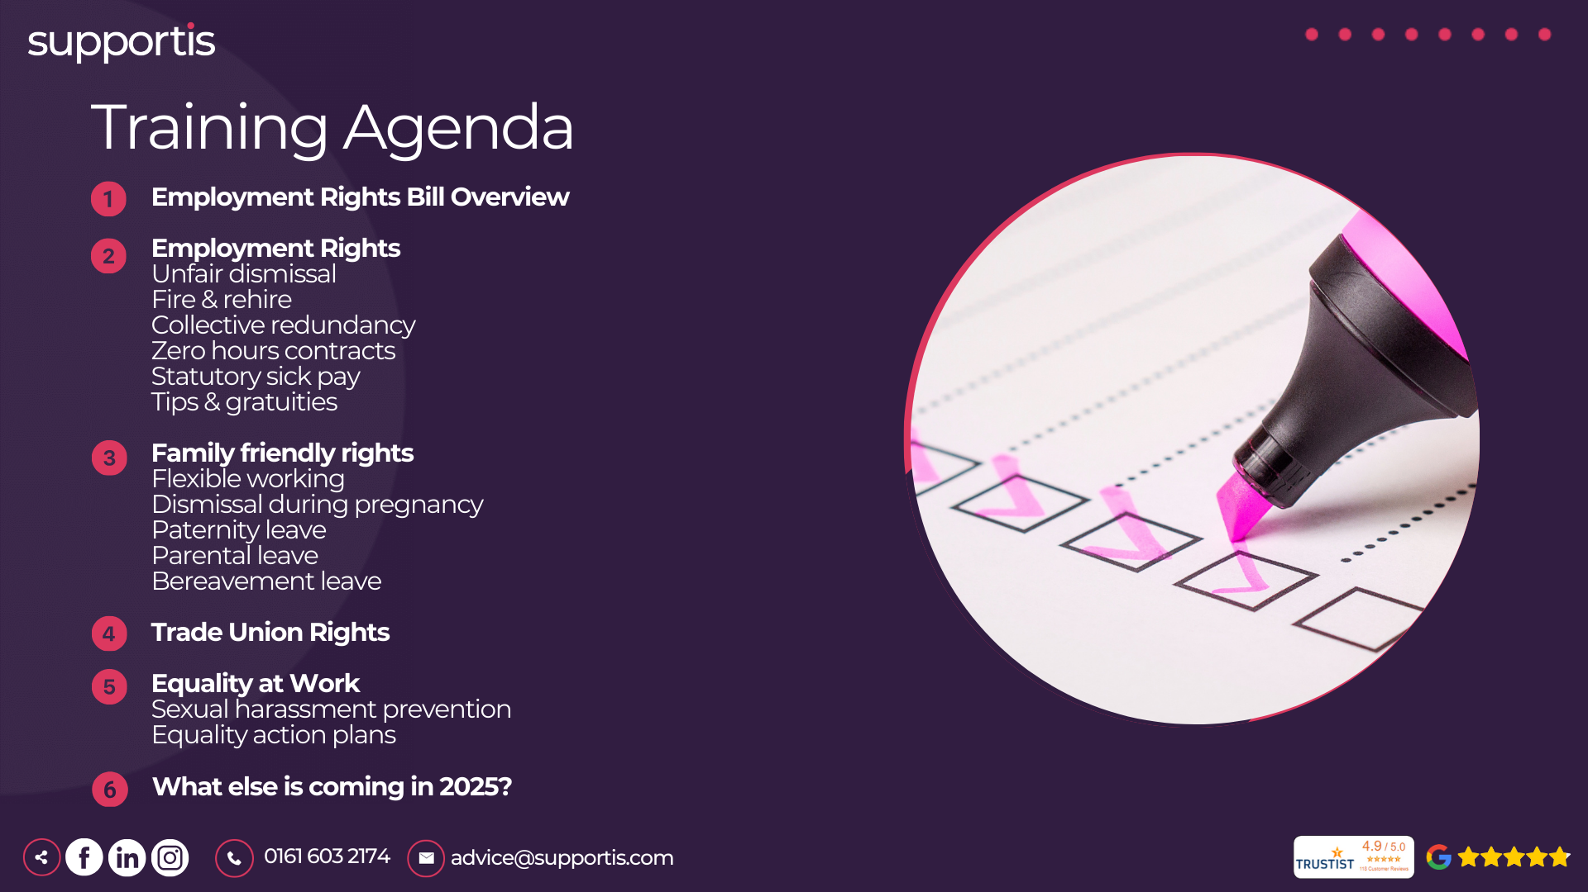
Notes:
"Good morning/afternoon, everyone. Today's session will provide an overview of the significant changes coming to employment law, primarily through the Employment Rights Bill and other related developments. These reforms represent the biggest shift in workers' rights in a generation, so it's crucial that we all understand the implications." "This slide outlines the key areas we'll be covering. As you can see, the changes touch upon a wide range of employment practices, from hiring and firing to family leave and workplace equality."

Slide 3
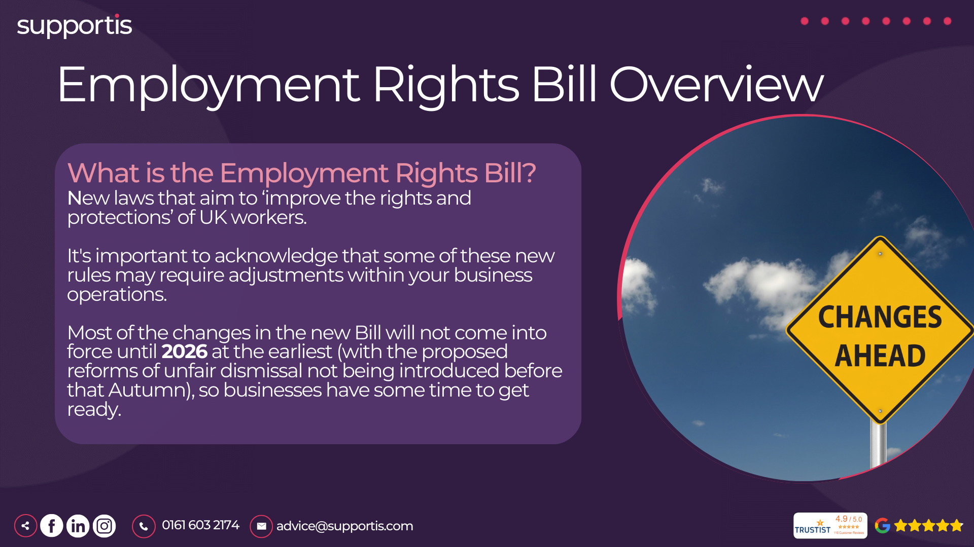
Notes:
The Employment Rights Bill is the foundation of these reforms. It introduces new protections for workers across various areas, which we'll explore in detail. Keep in mind that while the Bill is progressing, some specifics might evolve. We'll provide updates as they are confirmed."

Slide 4
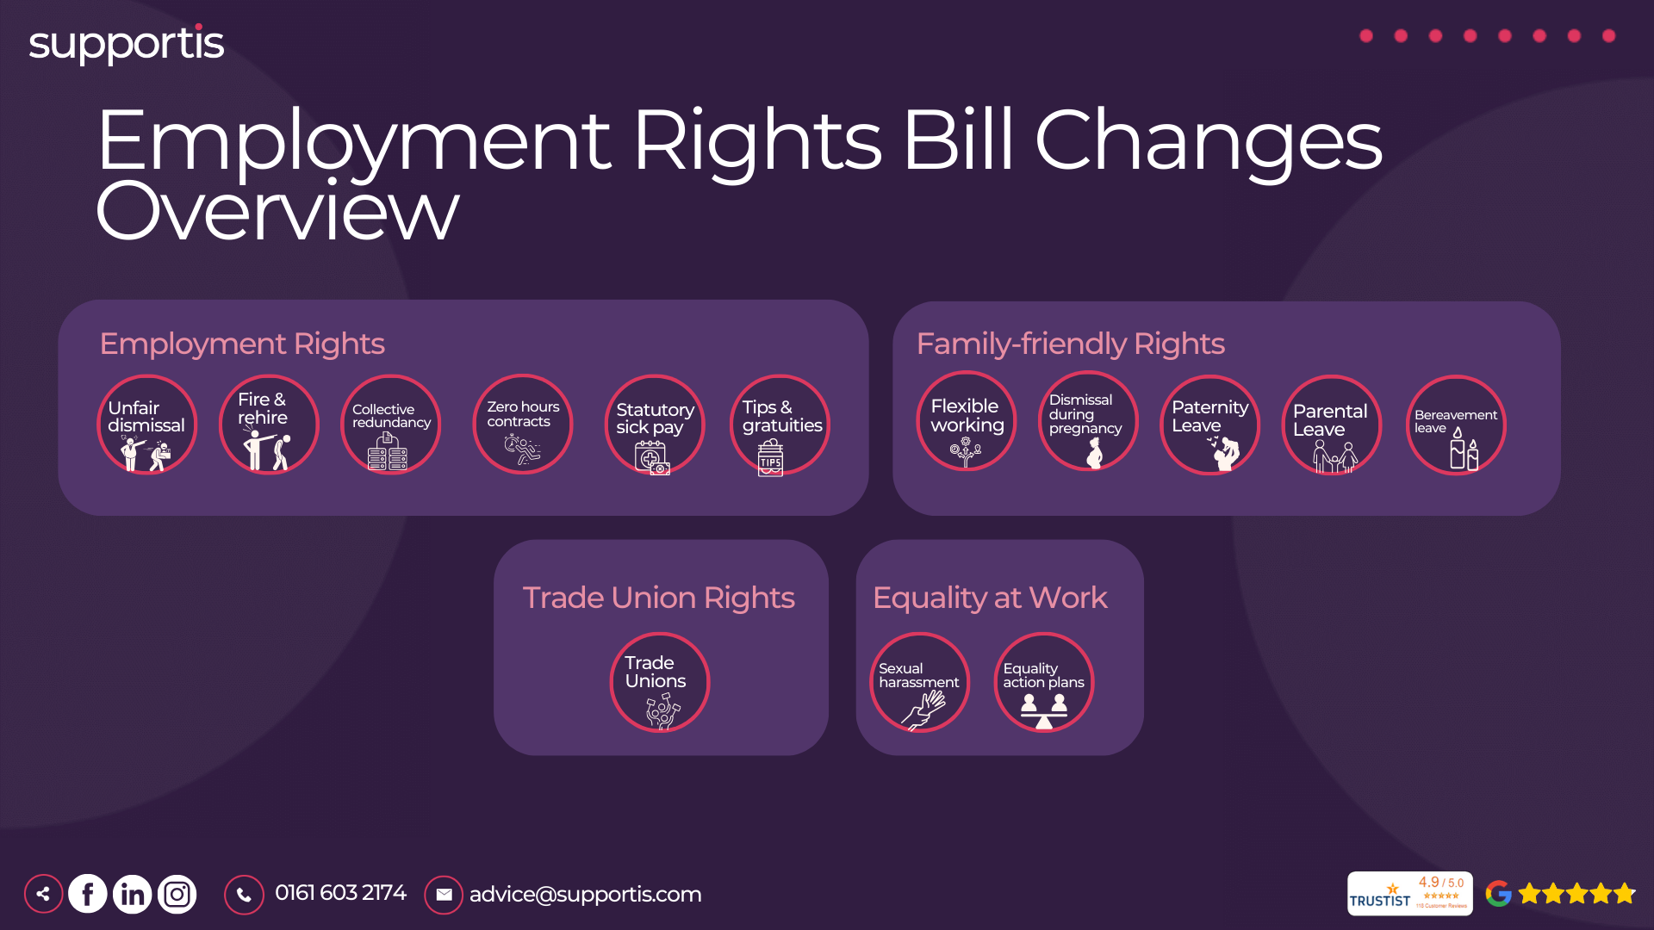

Slide 5
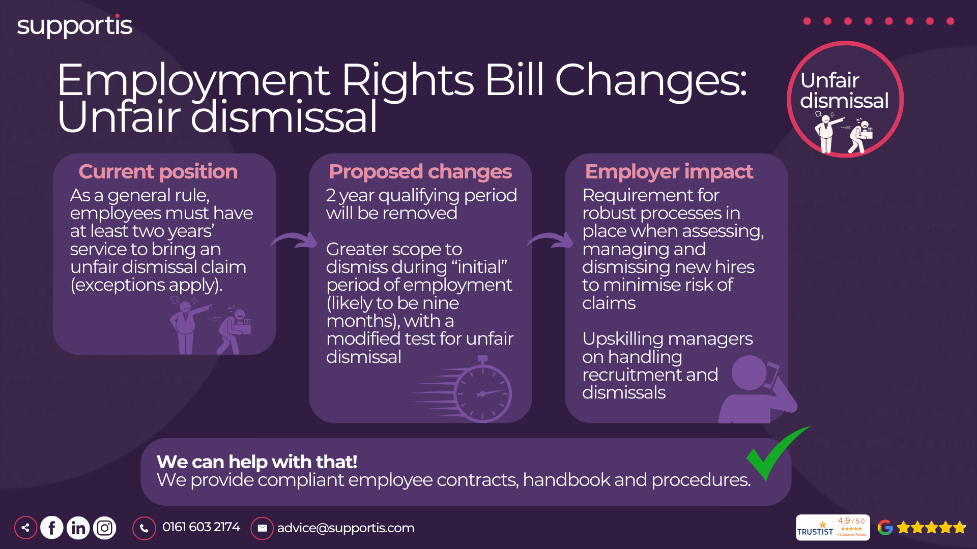
Notes:
Current Position: "Currently, employees generally need two years of continuous service to be eligible to claim unfair dismissal. There are some exceptions, but this is the general rule. This qualifying period has been a cornerstone of UK employment law for many years."
Proposed Changes: Removal of 2-Year Qualifying Period: "The most significant proposed change is the removal of the two-year qualifying period. This means employees could potentially bring unfair dismissal claims from day one of their employment. This is a major shift and will require employers to rethink their approach to managing new hires and probationary periods."
Greater Scope to Dismiss During "Initial" Period: "While the 2-year rule is being removed, there's likely to be a provision allowing for easier dismissals during an initial period of employment, potentially nine months. This initial period will likely have a modified test for unfair dismissal, offering some balance. However, it's crucial to remember that even during this period, dismissals must be handled fairly and lawfully."
Employer Impact: Requirement for Robust Processes: "These changes will necessitate robust HR processes from the outset. You'll need meticulous documentation of performance reviews, disciplinary procedures, and reasons for dismissal, even for new hires. This is essential to minimise the risk of unfair dismissal claims."
Upskilling Managers: "Managers will need training on how to handle recruitment, performance management, and dismissals effectively and fairly. They need to understand the new rules and the importance of following due process. Consistent and fair treatment of all employees is paramount."

Slide 6
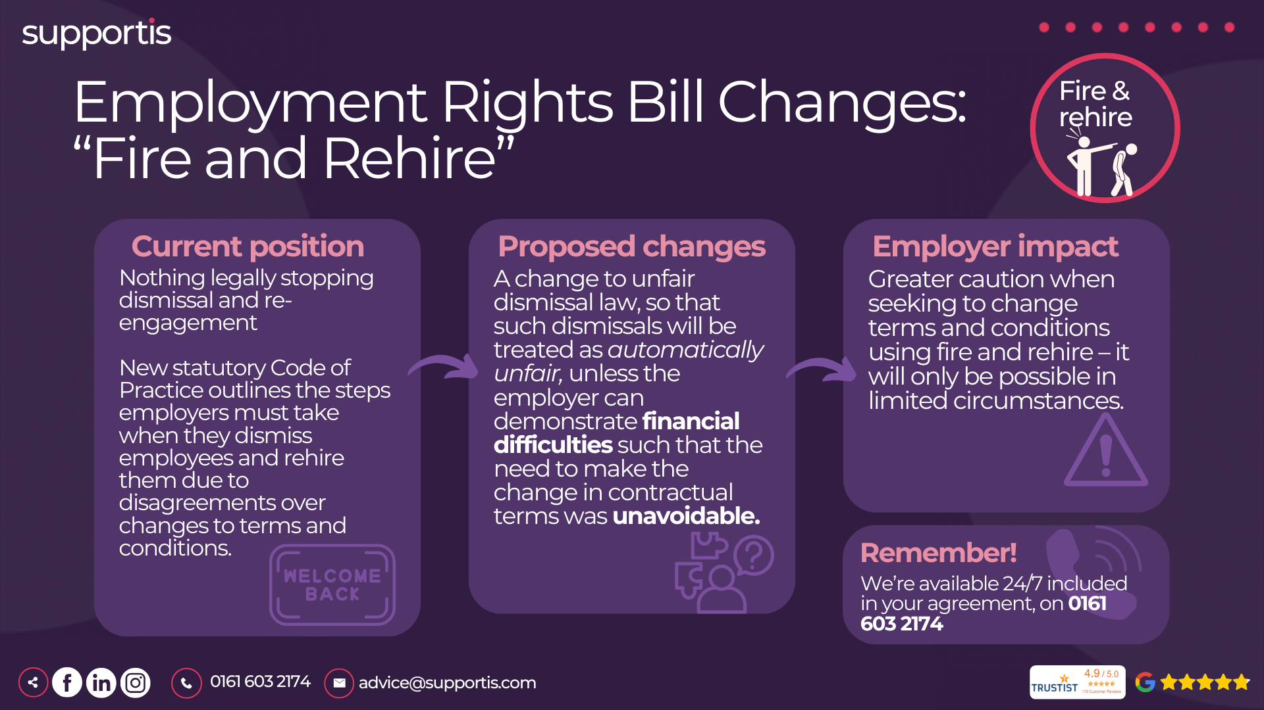
Notes:
Current Position: "Currently, there's nothing explicitly in law preventing an employer from dismissing employees and offering them new contracts. However, this practice has been heavily criticised, particularly when used aggressively to force employees to accept worse terms."
"A new statutory Code of Practice has been introduced, outlining the steps employers should take when using fire and rehire. While not legally binding in itself, it sets out expected standards and can be taken into account by employment tribunals."
Proposed Changes: Change to Unfair Dismissal Law: "The key proposed change is an amendment to unfair dismissal law. Dismissals connected to fire and rehire situations will be considered automatically unfair unless the employer can demonstrate two things:"
Financial Difficulties: "Firstly, they must show they were facing financial difficulties that made the change to contractual terms absolutely necessary."
Unavoidable Need: "Secondly, they must prove that making the changes through dismissal and rehire was unavoidable – that all other options had been thoroughly explored and exhausted."
High Threshold: "This sets a very high bar for employers to justify fire and rehire. It essentially means it will only be permissible as a last resort in situations of genuine financial crisis."
Employer Impact: Greater Caution: "Employers will need to exercise far greater caution when considering fire and rehire. It will no longer be a tool to simply impose new terms. They'll need to demonstrate a genuine business need and exhaust all alternatives."
Robust Consultation: "Thorough consultation with employees and potentially recognised trade unions is crucial. Employers must be able to show they've engaged meaningfully and explored all options before resorting to dismissal and rehire."
Evidentiary Burden: "Employers should meticulously document the financial difficulties they face, the alternatives explored, and the consultation process. They'll need strong evidence to defend their actions in an employment tribunal."

Slide 7
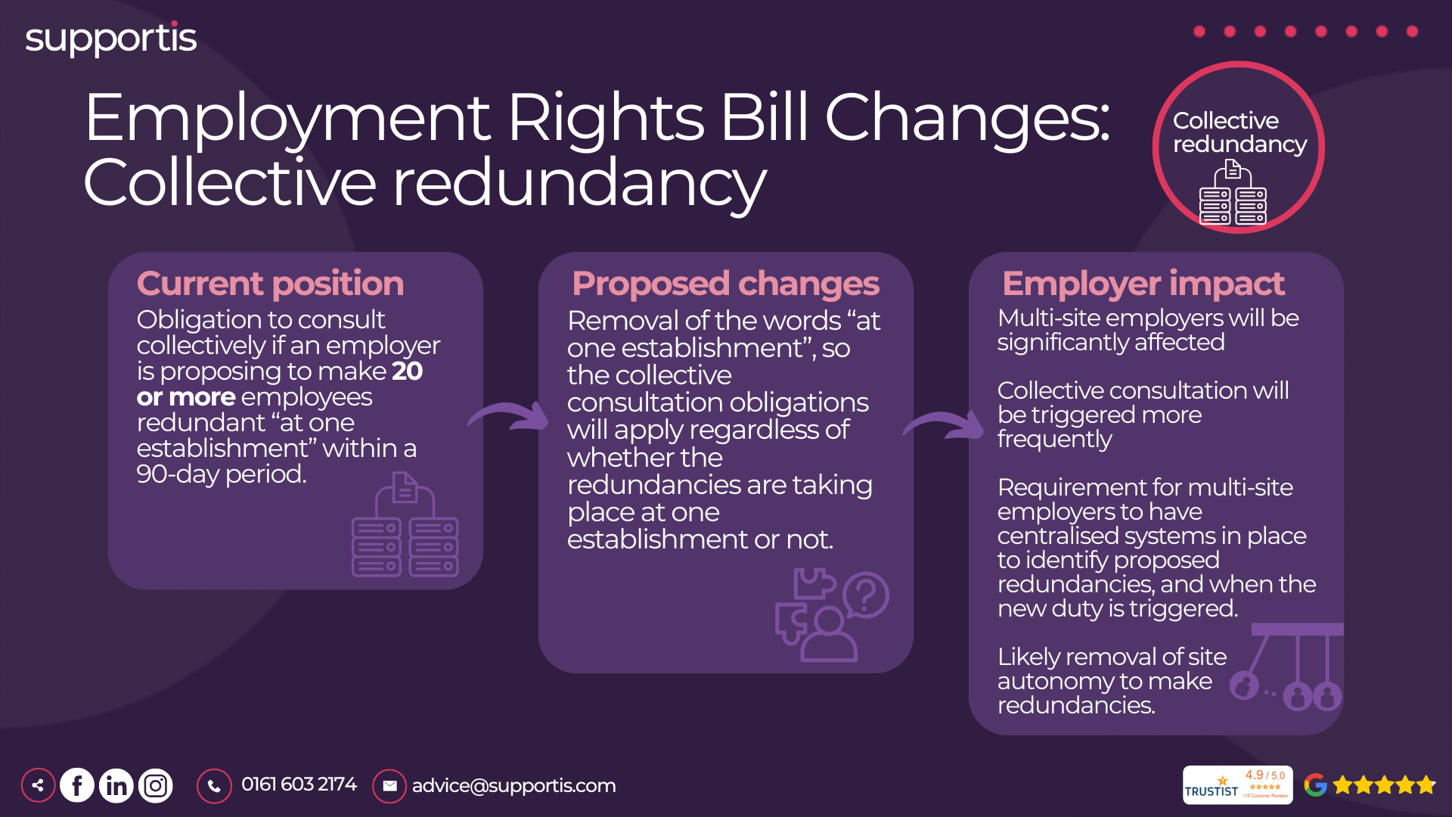
Notes:
Current Position: "Currently, employers have a legal obligation to consult collectively with employee representatives (typically trade unions or elected representatives) if they propose to make 20 or more employees redundant 'at one establishment' within a 90-day period."
"The key phrase here is 'at one establishment.' This has often been interpreted as a single physical location. This definition has, in some cases, allowed larger employers to avoid collective consultation by managing redundancies across multiple sites, even if the total number of redundancies exceeds 20."
Proposed Changes: Removal of "at one establishment": "The most significant proposed change is the removal of the phrase 'at one establishment.' This means the duty to consult collectively will apply to any proposed redundancies of 20 or more employees within a 90-day period, regardless of where those employees are based."
Focus on Total Number: "The trigger for collective consultation will now be based solely on the total number of proposed redundancies across the organisation, not the number at each individual location."
Employer Impact: Significant Impact on Multi-Site Employers: "This change will have a significant impact on businesses with multiple sites. They will need to adopt a more centralised approach to managing redundancies and will be subject to collective consultation requirements more frequently."
Increased Frequency of Consultation: "Multi-site employers will likely find themselves needing to conduct collective consultation much more often, as redundancies across different branches or offices will now count towards the 20-employee threshold."
Need for Centralised Systems: "Organisations will need to implement centralised systems to track proposed redundancies across all locations. This will enable them to identify when the 20-employee threshold is met and trigger the collective consultation process."
Potential Removal of Site Autonomy: "This change may also mean a reduction in autonomy for individual sites in making redundancy decisions. Central HR or a dedicated restructuring team will likely take a more prominent role."

Slide 8
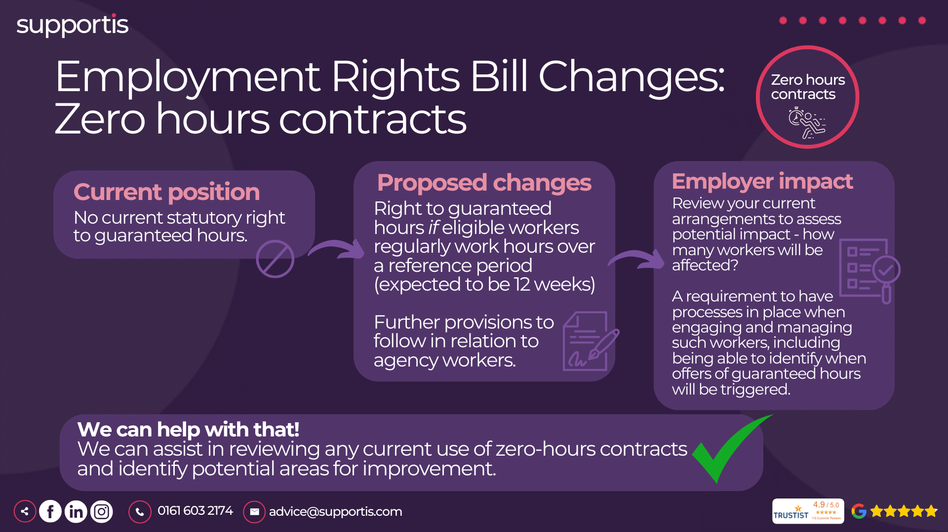
Notes:
Current Position: "Currently, there's no specific statutory right to guaranteed hours for workers on zero-hour contracts. Their work and pay depend on the availability of work and the employer's discretion."
"This lack of guaranteed hours can lead to significant financial insecurity and unpredictability for workers."
Proposed Changes: Right to Guaranteed Hours: "The key proposed change is the introduction of a right to guaranteed hours for eligible zero-hour workers. If a worker regularly works a certain number of hours over a reference period (expected to be 12 weeks), they will have the right to request guaranteed hours reflecting their regular work pattern."
Reference Period: "The 12-week reference period will be crucial in determining eligibility. It will likely involve assessing the average hours worked over those 12 weeks."
Process for Requesting Guaranteed Hours: "There will be a process for workers to request guaranteed hours. The details of this process, including eligibility criteria and how often requests can be made, will be set out in future regulations."
Employer Obligation: "Employers will have a duty to consider these requests reasonably. They cannot unreasonably refuse a request for guaranteed hours if the worker meets the eligibility criteria."
Agency Workers: "The slide mentions further provisions to follow in relation to agency workers. This is important to note, as there's often overlap between zero-hour contracts and agency work. We'll need to wait for further details on how these provisions will impact agency workers."
Employer Impact: Review of Current Arrangements: "Employers using zero-hour contracts will need to review their current arrangements to assess the potential impact of these changes. They need to identify how many workers might be eligible for guaranteed hours and how this might affect workforce planning and budgeting."
Process Implementation: "Businesses will need to have processes in place to manage requests for guaranteed hours, including a system for tracking hours worked and assessing eligibility."
Potential Cost Implications: "There may be cost implications if employers are required to guarantee a certain number of hours to workers, even if there's not always work available. This needs to be factored into workforce planning."

Slide 9
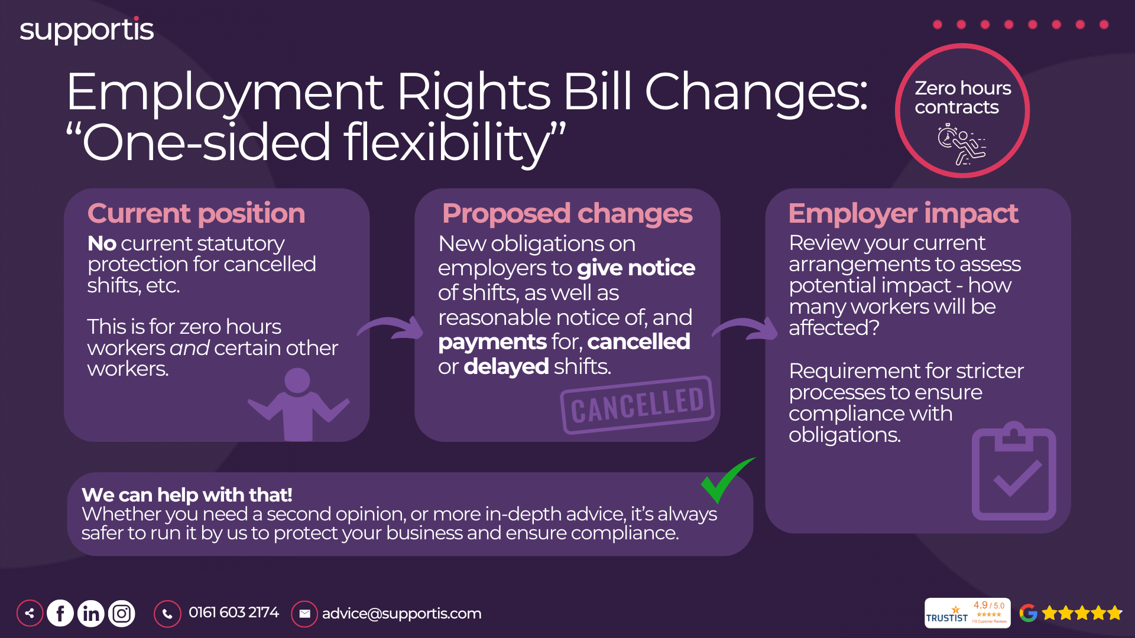
Notes:
Current Position: "Currently, there's no specific statutory protection for workers when shifts are canceled or significantly delayed by the employer. Workers on zero-hour contracts and other flexible arrangements are particularly vulnerable to this type of unpredictability."
"This lack of protection can make it difficult for workers to plan their lives, manage childcare, or ensure a stable income."
Proposed Changes: New Obligations on Employers: "The key proposed change is the introduction of new obligations on employers regarding shift changes and cancellations. Employers will be required to:"
Give Reasonable Notice: "Provide reasonable notice of any changes to scheduled shifts. The definition of 'reasonable notice' will likely be set out in future regulations, but it's expected to be longer than the current often very short or non-existent notice periods."
Payment for Cancelled or Delayed Shifts: "Provide compensation to workers when shifts are canceled or significantly delayed with insufficient notice. This payment will likely act as a deterrent against last-minute changes and provide some financial security for affected workers."
Scope: "These new obligations will apply primarily to zero-hour workers and other workers with similar flexible or unpredictable work patterns."
Employer Impact: Review of Current Practices: "Employers will need to review their current practices regarding scheduling and shift changes. They need to assess how often they make changes with short notice and identify areas for improvement."
Process Implementation: "Businesses will need to implement new processes for notifying workers of shift changes and cancellations, as well as for calculating and processing payments for affected workers."
Potential Cost Implications: "There may be cost implications associated with compensating workers for canceled or delayed shifts. This needs to be factored into workforce planning and budgeting."
Improved Communication: "These changes will necessitate improved communication and coordination between employers and workers regarding scheduling and shift changes."

Slide 10
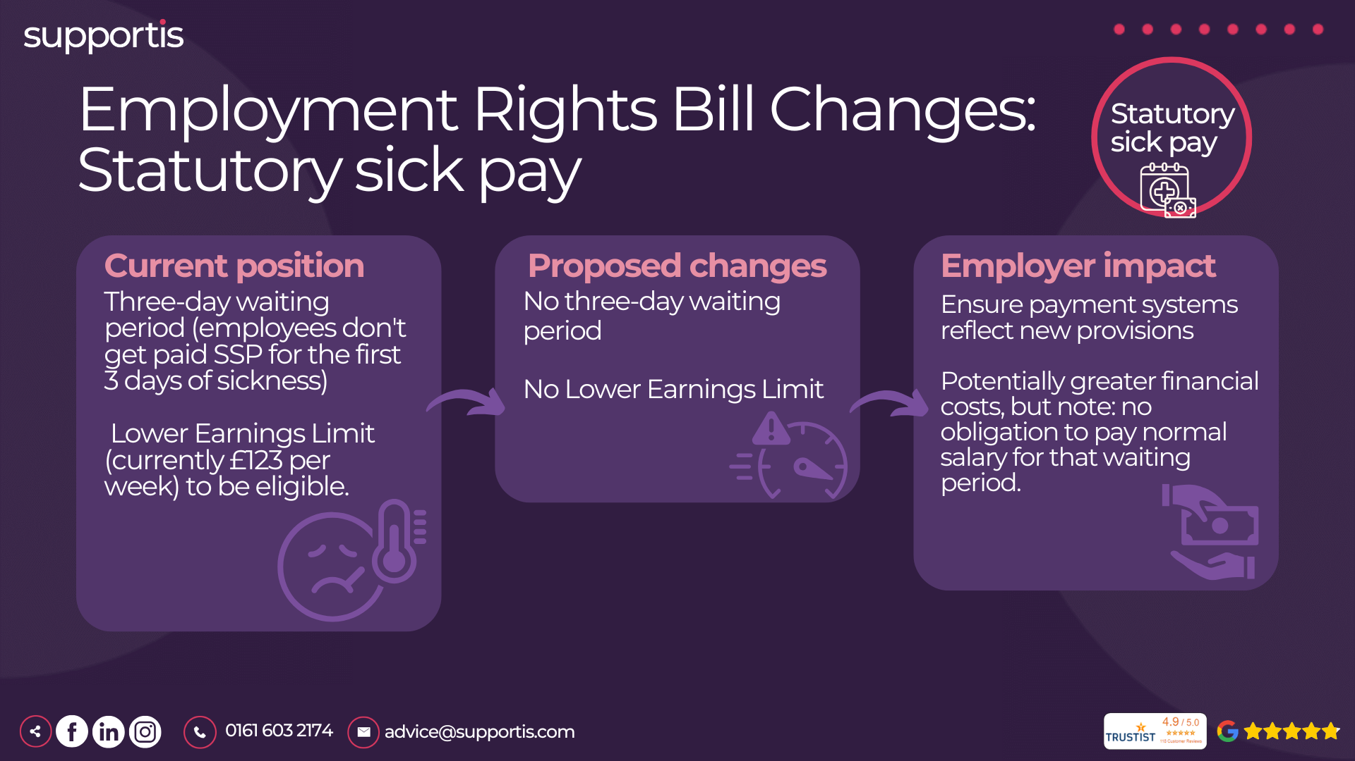
Notes:
Current Position: Three-Day Waiting Period: "Currently, there's a three-day waiting period before employees are eligible to receive SSP. This means they don't get paid for the first three days of sickness absence."
Lower Earnings Limit: "Employees must earn at least the Lower Earnings Limit (currently £123 per week) to be eligible for SSP."
Proposed Changes: Removal of Waiting Days: "The government proposes to remove the three-day waiting period. This means employees will be entitled to SSP from the first day of sickness absence."
Removal of Lower Earnings Limit: "The Lower Earnings Limit is also proposed to be removed, making SSP accessible to a wider range of workers, including those on low incomes or with variable hours."
Employer Impact: Payment System Updates: "Employers will need to update their payroll and absence management systems to reflect these changes and ensure SSP is paid correctly from day one."
Potential Cost Implications: "Removing the waiting days and the Lower Earnings Limit will likely lead to increased SSP costs for businesses, as more employees will become eligible and payments will start sooner."
Note on Normal Salary: "It's important to note that there's no obligation to pay an employee's normal (full) salary for those initial waiting days, even if SSP is now payable from day one. SSP is a lower, set rate."

Slide 11
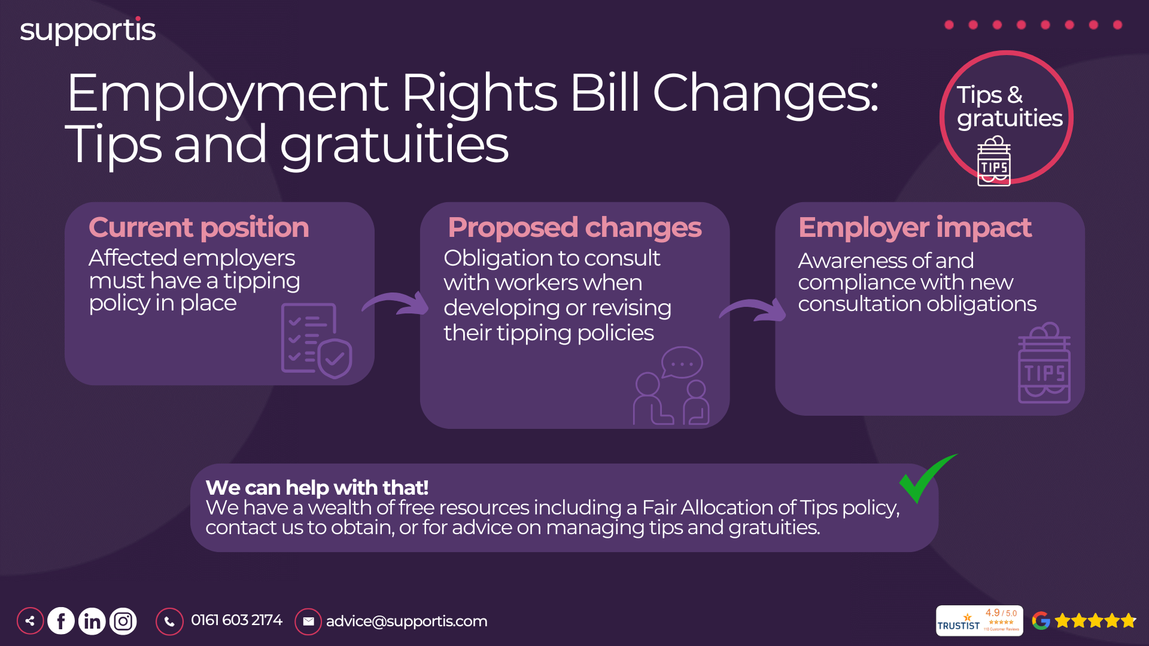
Notes:
Current Position: "Currently, affected employers are required to have a tipping policy in place. This policy outlines how tips and gratuities are collected, distributed, and managed within the business."
"However, there isn't a specific legal requirement to consult with staff on the creation or revision of this policy."
Proposed Changes: Obligation to Consult: "The key change is the introduction of a legal obligation to consult with workers when developing or revising tipping policies. This means we'll need to engage with our staff and/or their representatives to get their input and feedback on how tips are handled."
"The specifics of what constitutes 'reasonable consultation' are likely to be detailed in future guidance or regulations. However, we should anticipate a need for meaningful dialogue and consideration of staff views."
Employer Impact: Awareness and Compliance: "We need to ensure that all relevant managers and staff are aware of these upcoming changes and understand our obligations. This includes HR, operations managers, and anyone involved in handling tips and gratuities."
Policy Review and Updates: "We'll need to review our existing tipping policy and make any necessary updates to ensure compliance with the new legislation. This will include documenting the consultation process and demonstrating that we've taken staff feedback into account."
Training: "Training may be required for staff on the updated policy and procedures, particularly for those responsible for collecting and distributing tips."

Slide 12
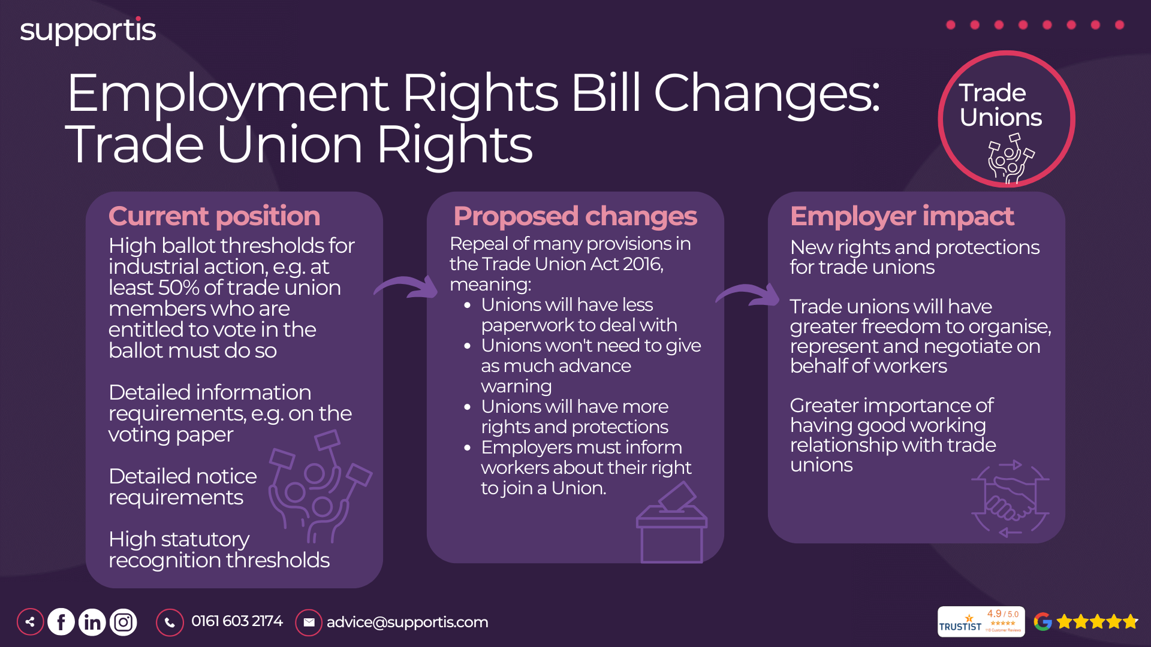
Notes:
Current Position: "Currently, there are several restrictions and requirements in place regarding trade union activities, including:"
High Ballot Thresholds: "Strict balloting thresholds for industrial action, such as requiring at least 50% of eligible union members to vote in favour. This makes it more challenging for unions to organise lawful industrial action."
Detailed Information Requirements: "Unions face detailed requirements regarding information provided on voting papers and in notices related to industrial action."
Detailed Notice Requirements: "Specific notice periods are required before industrial action can take place, allowing employers time to prepare."
High Statutory Recognition Thresholds: "Strict thresholds exist for unions to gain statutory recognition, meaning the employer is legally obligated to negotiate with them."
Proposed Changes: Repeal of Provisions: "Many of the provisions introduced by the Trade Union Act 2016 are proposed to be repealed. This signals a move towards reducing restrictions on union activities."
Specific Changes:
Relaxation of Balloting Rules: "While details are pending, it's anticipated that some of the stricter requirements around industrial action ballots may be relaxed."
Reduced Notice Periods: "Changes are expected to notice periods required for industrial action, potentially shortening them."
Easier Statutory Recognition: "It's possible that changes will make it easier for unions to achieve statutory recognition."
Employer Duty to Inform: "Employers may have a new duty to inform workers about their right to join a union."
Employer Impact: New Rights and Protections for Unions: "These changes will likely result in new rights and protections for trade unions, strengthening their ability to organize and represent workers."
Greater Freedom for Unions: "Unions will likely have greater freedom to organize, represent, and negotiate on behalf of their members."
Increased Importance of Positive Relationships: "It will be more important than ever to foster positive and productive working relationships with trade unions to ensure open communication and collaboration."
Potential for Increased Union Activity: "We should be prepared for a potential increase in union activity, including organizing efforts and potential industrial action."

Slide 13
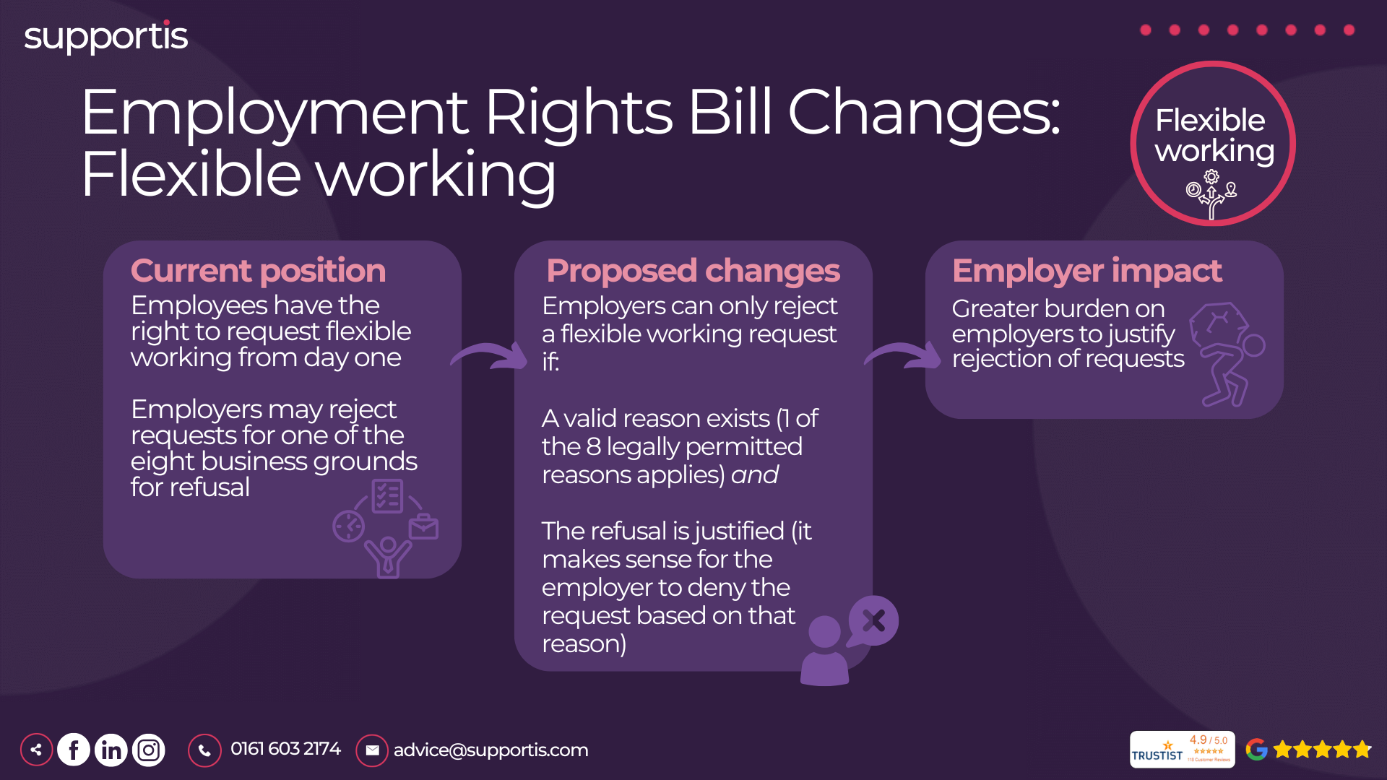
Notes:
Current Position: "Currently, employees have the right to request flexible working from day one of their employment. This means they can ask for changes to their working hours, patterns, or location."
"Employers may reject these requests for one of eight specified business reasons. These reasons provide a framework for decision-making, but it's important to apply them consistently and fairly."
Proposed Changes: "The proposed changes aim to strengthen employees' rights to request flexible working and place a greater emphasis on employers considering these requests seriously."
Key Change: "Employers can only reject a flexible working request if:
A valid reason exists (one of the 8 legally permitted reasons applies).
The refusal is justified (it makes sense for the employer to deny the request based on that reason)."
"This means simply citing a reason isn't enough; the employer must demonstrate that refusing the request is a proportionate means of achieving a legitimate aim."
Employer Impact: Greater Burden on Employers: "These changes will place a greater burden on employers to carefully consider and justify any rejections of flexible working requests. We need to ensure our decision-making process is robust and fair."
Transparency and Consistency: "We need to be transparent about how we assess requests and ensure consistency in our decision-making across the organization. This will help avoid claims of discrimination or unfair treatment."
Training for Managers: "Managers will need training on how to handle flexible working requests effectively, including how to assess requests against the legally permitted reasons and how to document their decisions."
Attracting and Retaining Talent: "Adopting a positive and open approach to flexible working can help us attract and retain talent in a competitive job market. It can also improve employee morale and productivity."

Slide 14
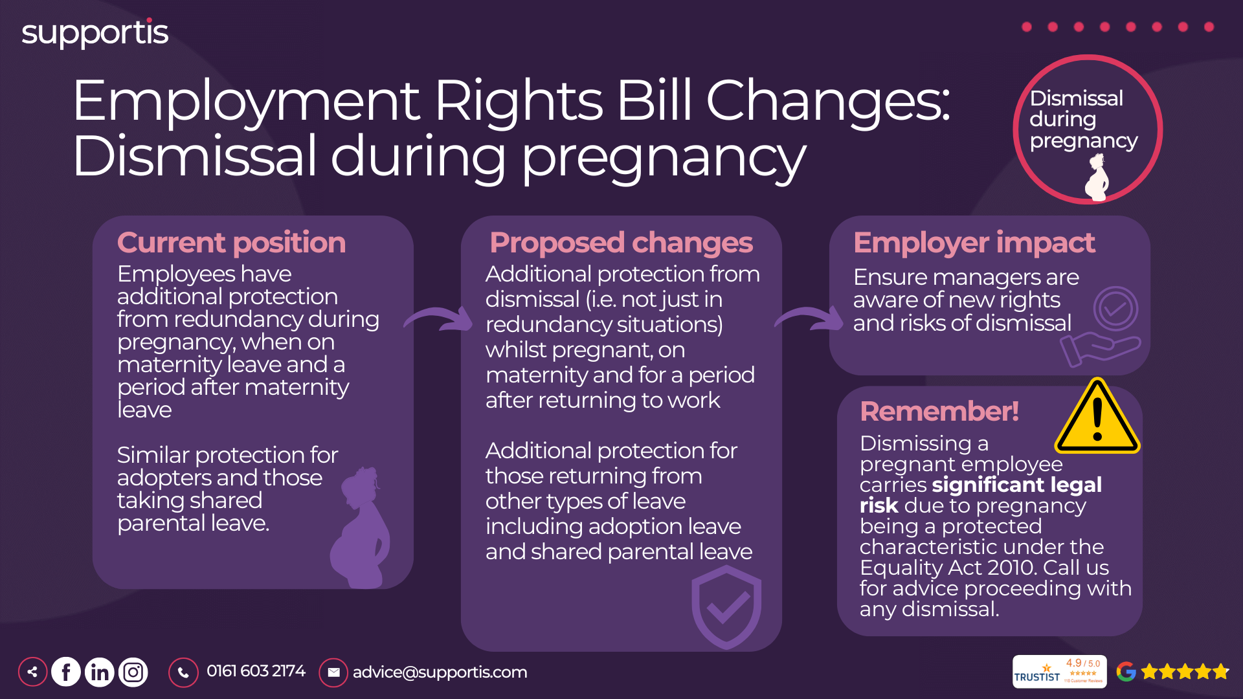
Notes:
Current Position: "Currently, employees already have some protection against redundancy during pregnancy and specific leave periods (maternity, adoption, shared parental leave). However, the protection isn't as comprehensive as it could be."
"Protection is primarily focused on redundancy situations, meaning other types of dismissals during this period might not be explicitly covered."
Proposed Changes: Additional Protection from Dismissal: "The key change is the introduction of additional protection from any dismissal (not just redundancy) during pregnancy, on maternity leave, and for a protected period after the employee returns to work."
"This means that dismissing an employee for any reason related to their pregnancy or maternity leave will be automatically unfair."
Extension to Other Leave: "Similar protection will be extended to employees taking adoption leave and shared parental leave, ensuring consistency and fairness."
Employer Impact: Increased Awareness and Training: "Managers and HR professionals need to be acutely aware of these enhanced rights and receive appropriate training to ensure compliance. Any dismissal during this protected period carries extremely high legal risk."
Significant Legal Risk: "Dismissing a pregnant employee, or an employee on or returning from maternity/adoption/shared parental leave, carries significant legal risk due to pregnancy being a protected characteristic under the Equality Act 2010. Claims related to such dismissals can lead to substantial compensation and reputational damage."
Need for Robust Processes: "Employers need robust HR processes to manage performance issues, disciplinary matters, and potential dismissals involving pregnant employees or those on related leave. Thorough documentation and careful consideration are essential."

Slide 15
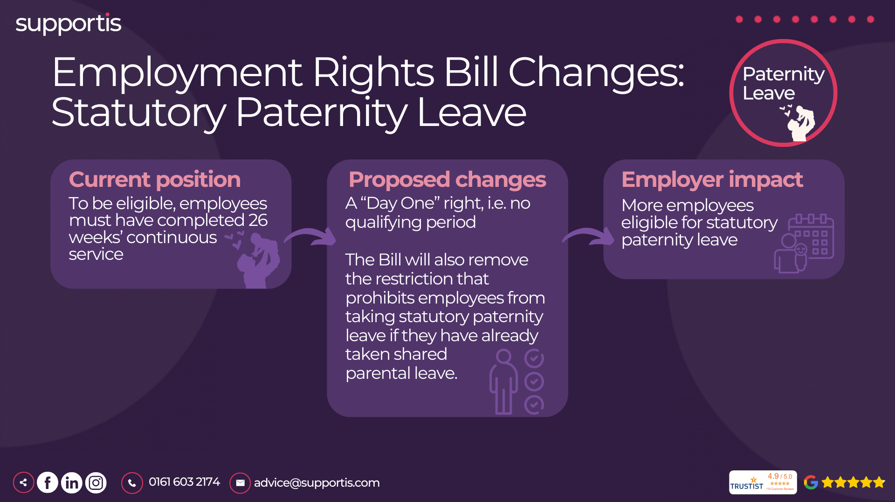
Notes:
Current Position: "Currently, to be eligible for Statutory Paternity Leave, employees must have completed 26 weeks of continuous service with their employer."
"In addition, there are restrictions on taking paternity leave if the employee has already taken shared parental leave."
Proposed Changes: "Day One" Right: "The most significant change is the removal of the 26-week qualifying period. This means eligible employees will have the right to take Statutory Paternity Leave from day one of their employment."
Removal of Restriction: "The Bill will also remove the restriction that prevents employees from taking statutory paternity leave if they have already taken shared parental leave. This will provide greater flexibility for fathers in how they choose to use their parental leave entitlements."
Employer Impact: Increased Eligibility: "The removal of the qualifying period means more employees will be eligible for Statutory Paternity Leave, potentially leading to an increase in requests."
Policy Updates: "Businesses will need to update their paternity leave policies to reflect these changes and ensure they are compliant with the new legislation."
Workforce Planning: "Employers should prepare for a potential increase in paternity leave requests and consider how this might impact workforce planning and coverage."
Understanding Interaction with Shared Parental Leave: "It's crucial to understand how these changes interact with shared parental leave entitlements to advise employees accurately and manage leave requests effectively."

Slide 16
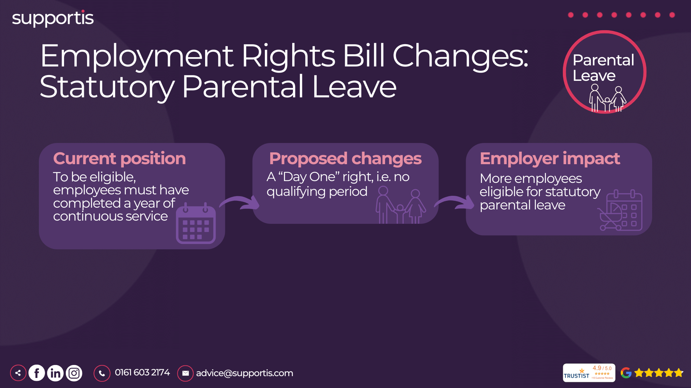
Notes:
Current Position: "Currently, employees must have completed one year of continuous service with their employer to be eligible for Statutory Parental Leave."
"This qualifying period can be a barrier for newer employees who may wish to take parental leave."
Proposed Changes: "Day One" Right: "The key proposed change is the removal of the one-year qualifying period. This means eligible employees will have the right to take Statutory Parental Leave from day one of their employment."
Increased Access: "This change significantly increases access to parental leave, particularly for those starting new jobs who wish to take leave soon after joining a company."
Phased Approach (Likely): "While the slide doesn't mention it, it's worth noting that the current entitlement to parental leave is 18 weeks per child, but this can only be taken after the first year of employment. It's likely that the removal of the qualifying period will be accompanied by a phased approach to how much leave can be taken in the first year. We'll need to wait for details, but it's unlikely employees will be able to take all 18 weeks immediately."
Employer Impact: Increased Eligibility: "The removal of the qualifying period means more employees will be eligible for Statutory Parental Leave, potentially leading to an increase in requests, particularly from new hires."
Policy Updates: "Businesses will need to update their parental leave policies to reflect these changes and ensure they are compliant with the new legislation."
Workforce Planning: "Employers should prepare for a potential increase in parental leave requests and consider how this might impact workforce planning and coverage, especially during recruitment and onboarding periods."
Managing Employee Expectations: "Given the likelihood of a phased approach to the leave entitlement, clear communication with employees about what they are eligible for and when will be vital to manage expectations."

Slide 17
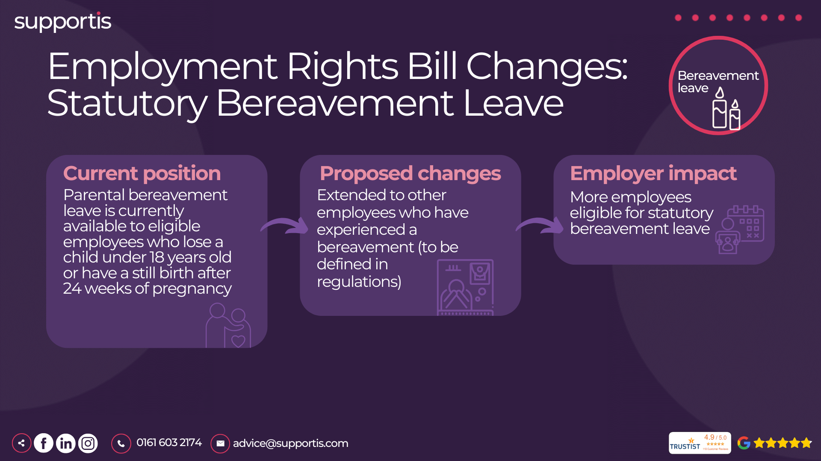
Notes:
Current Position: "Currently, there's no general statutory right to bereavement leave. Parental bereavement leave is available for employees who lose a child under 18 or experience a stillbirth after 24 weeks of pregnancy."
"Many employers offer some form of compassionate leave, but there's no legal obligation to do so beyond the specific provision for parental bereavement."
Proposed Changes: Extension to Other Bereavements: "The key change is the proposal to extend statutory bereavement leave to other employees who have experienced a bereavement. The specific definition of what constitutes a qualifying bereavement will be detailed in future regulations."
"This suggests a move towards recognizing the need for bereavement leave beyond the loss of a child, encompassing a wider range of relationships and circumstances."
Employer Impact: Increased Eligibility: "More employees will become eligible for statutory bereavement leave, potentially leading to an increase in requests."
Policy Development: "Businesses will need to develop or update their bereavement leave policies to reflect these changes and ensure they are compliant with the new legislation."
Training for Managers: "Managers will need training on how to handle bereavement leave requests with sensitivity and in accordance with the updated policies and legal requirements."
Workplace Culture: "These changes highlight the importance of fostering a supportive and compassionate workplace culture that recognizes the impact of bereavement on employees."

Slide 18
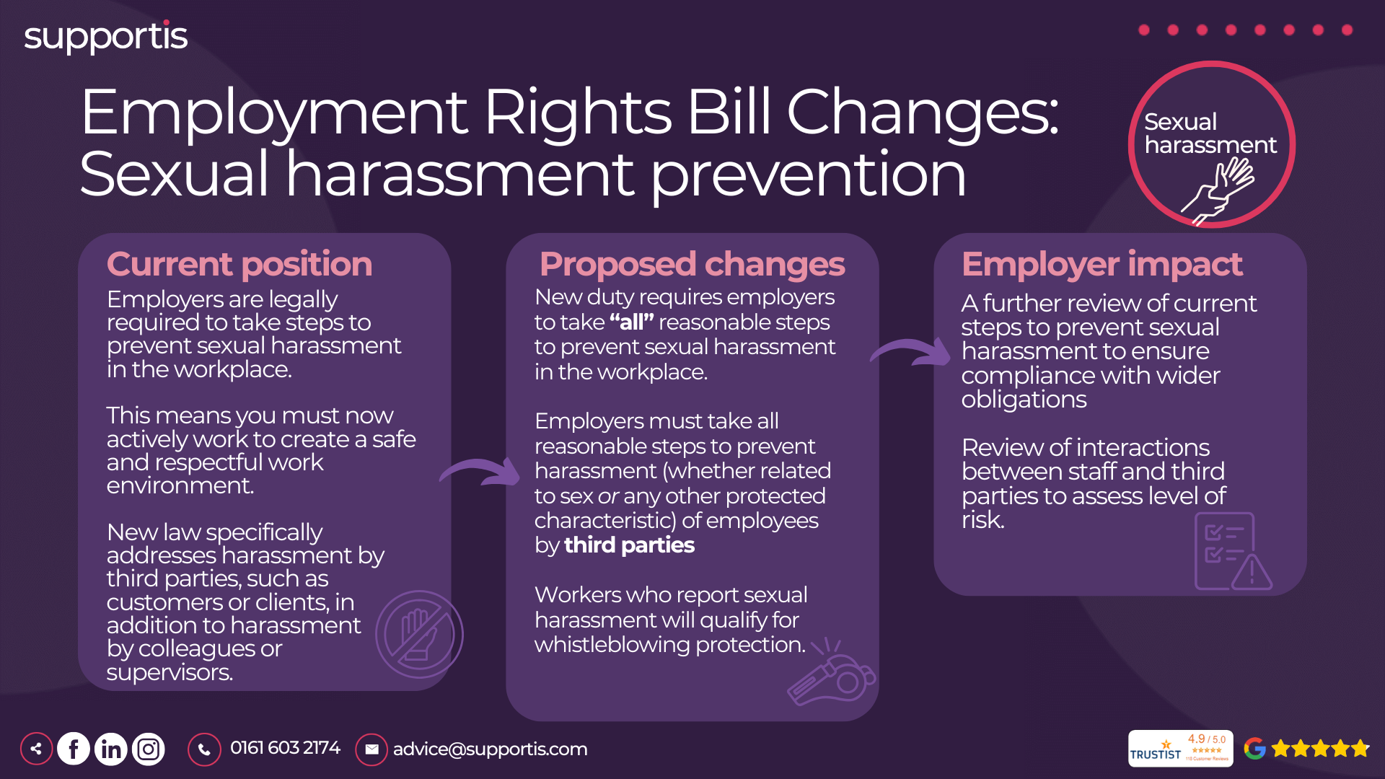
Notes:
Current Position: "Employers already have a legal duty to take reasonable steps to prevent sexual harassment in the workplace. This means creating a safe and respectful work environment and implementing policies and procedures to address complaints."
Proposed Changes: "All Reasonable Steps" Requirement: "The new legislation introduces a stricter requirement for employers to take "all" reasonable steps to prevent sexual harassment. This means a more proactive and comprehensive approach is needed."
Harassment by Third Parties: "The changes specifically address harassment by third parties, such as customers, clients, or suppliers. Employers now have a responsibility to take reasonable steps to prevent and address such harassment."
Whistleblowing Protection: "Employees who report sexual harassment will be protected under whistleblowing legislation, providing them with greater security when raising concerns."
Employer Impact: Review Current Practices: "Employers should review their current policies, procedures, and training to ensure they are adequate to meet the new "all reasonable steps" requirement."
Address Third-Party Harassment: "Employers need to assess the risks of harassment by third parties and develop appropriate measures to prevent and address such incidents."
Promote a Culture of Respect: "Creating a culture of respect and zero tolerance for sexual harassment is essential. This involves training employees, raising awareness, and encouraging open reporting."

Slide 19
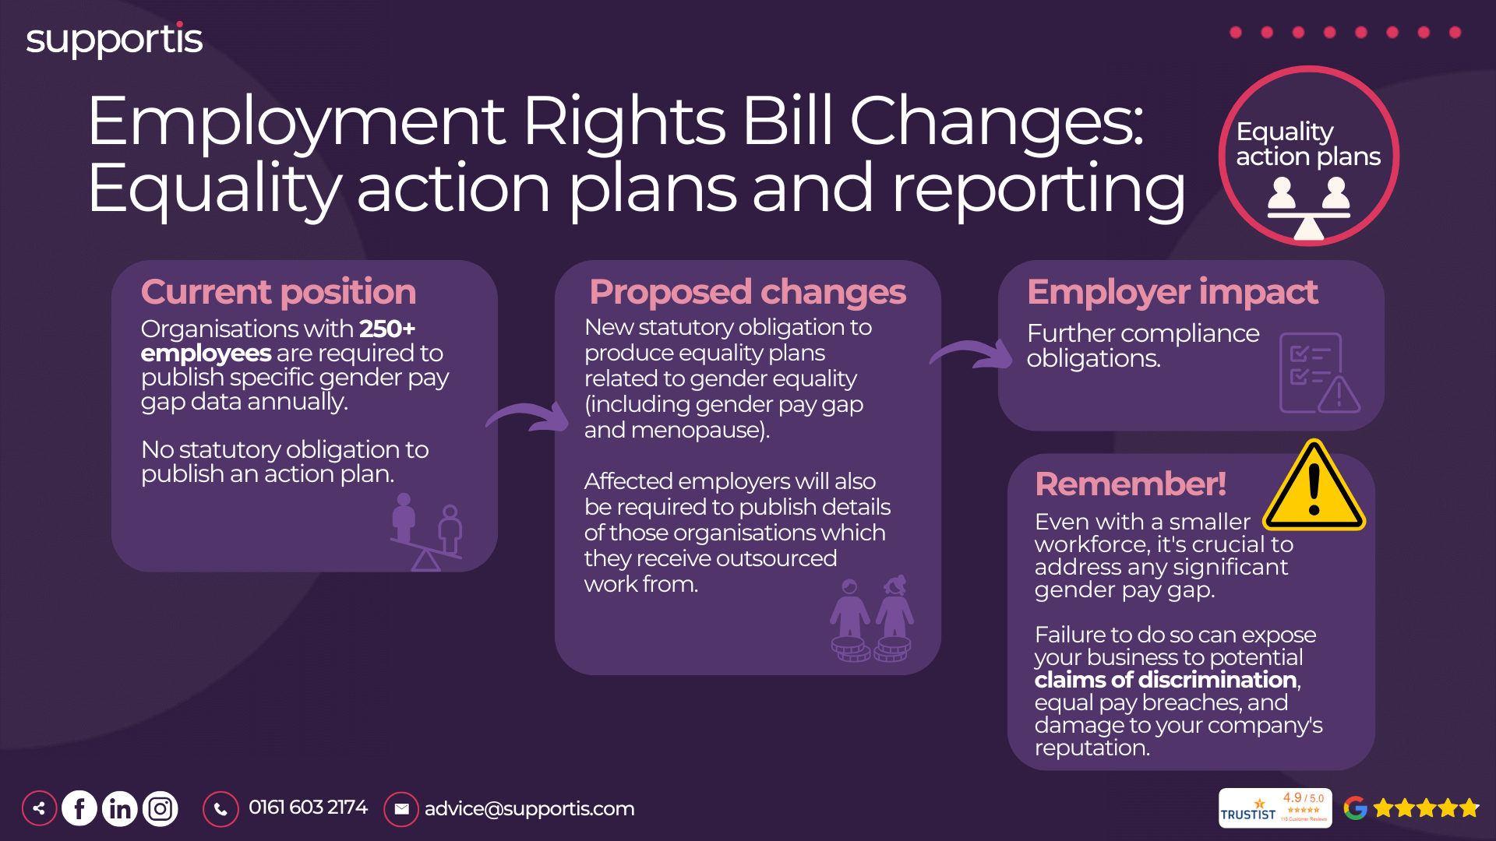
Notes:
Current Position: "Currently, organizations with 250 or more employees are required to publish specific gender pay gap data annually. This data provides a snapshot of the difference in average earnings between men and women across the organization."
"While publishing the data is mandatory, there's no statutory obligation to create or publish an action plan outlining how the organization intends to address any identified pay gaps."
Proposed Changes: New Statutory Obligation: "The key change is the introduction of a new statutory obligation for affected employers to produce and publish equality action plans related to gender equality. These plans will need to outline specific steps the organization will take to address its gender pay gap and promote equality in the workplace."
Scope: "The action plans will need to cover various aspects of gender equality, including pay, recruitment, promotion, training, and flexible working opportunities. It's anticipated that guidance will be provided on what should be included in the action plans."
Outsourcing Details: "Affected employers will also be required to publish details of organizations from which they receive outsourced work. This aims to promote transparency across supply chains and encourage wider action on equality."
Employer Impact: Further Compliance Obligations: "These changes will introduce further compliance obligations for businesses, particularly larger ones. Organizations will need to dedicate resources to developing, implementing, and monitoring their equality action plans."
Addressing Pay Gaps: "The focus on action plans aims to drive employers to take proactive steps to address gender pay gaps and promote equal opportunities. This may involve setting targets, implementing new policies, or reviewing existing practices."

Slide 20
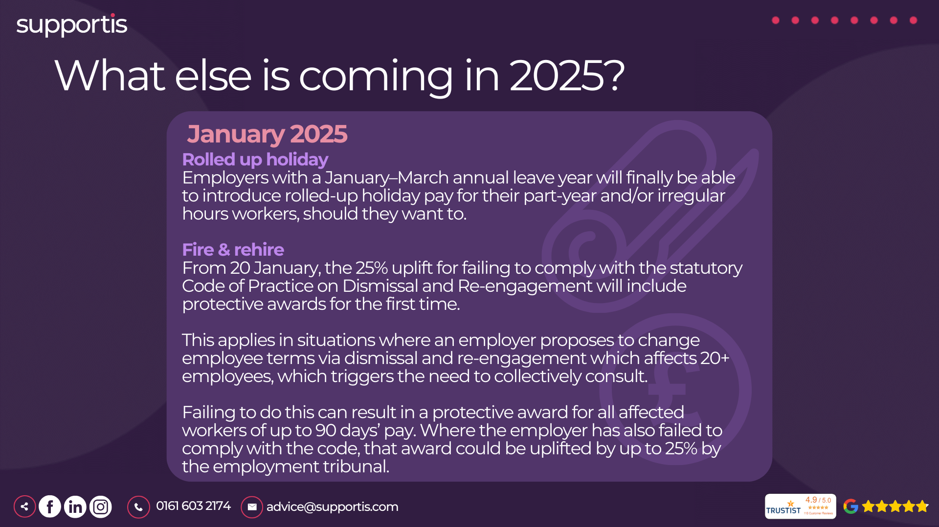
Notes:
Rolled-up Holiday Pay (January 2025): Current Situation: "Currently, rolled-up holiday pay, where holiday pay is included in an employee's regular pay rather than being paid separately when leave is taken, is complex and can be legally challenging."
New Flexibility: "From January 2025, employers with a January-March annual leave year will have the option to introduce rolled-up holiday pay for part-year and/or irregular hours workers if they choose to. This provides more flexibility for both employers and employees."
Considerations: "While this offers flexibility, it's crucial to ensure it's implemented correctly and transparently to avoid potential legal issues. We'll need to carefully consider if this option is beneficial for our workforce and how to implement it fairly."
Fire and Rehire (January 2025): Background: "Fire and rehire, the practice of dismissing employees and then rehiring them on new terms, has been controversial. The government has introduced a statutory Code of Practice on Dismissal and Re-engagement to provide guidance on how to conduct this process fairly."
Increased Penalties: "From January 20th, 2025, failing to comply with this Code of Practice will carry significant penalties. A 25% uplift can be applied to protective awards for failing to properly consult when making 20 or more redundancies (which often accompanies fire and rehire). This applies even if the original dismissal was fair. If the employer has also failed to comply with the Code, that award could be uplifted by up to 25% by the employment tribunal. This means non-compliance could be very costly."
Collective Consultation: "Remember, if fire and rehire affects 20 or more employees, it triggers the need for collective consultation. Failing to do this can result in substantial penalties."
Implications: "These changes reinforce the importance of following the Code of Practice and engaging in meaningful consultation with employees when considering changes to terms and conditions. It also significantly increases the financial risks of non-compliance."

Slide 21
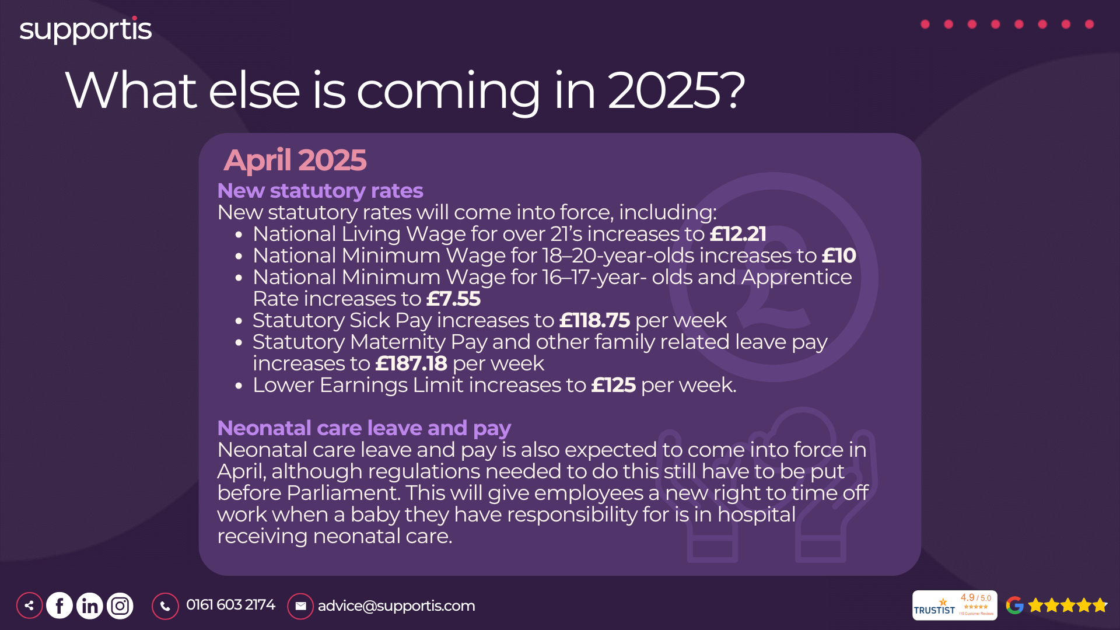
Notes:
New Statutory Rates (April 2025): National Living Wage (NLW): "The National Living Wage for those aged 21 and over will increase to £12.21 per hour. This is a crucial update for payroll and budgeting, especially for businesses with a significant proportion of staff at this wage level."
National Minimum Wage (NMW): "The National Minimum Wage rates for other age groups will also increase: £10 for 18-20-year-olds, and £7.55 for 16-17-year-olds and apprentices. Again, this requires careful attention from payroll and HR."
Statutory Sick Pay (SSP): "Statutory Sick Pay will increase to £118.75 per week. This will impact absence management and associated costs."
Statutory Maternity Pay (SMP) and Other Family Leave Pay: "Statutory Maternity Pay and other family-related leave pay, including paternity, adoption, and shared parental pay, will increase to £187.18 per week. This has implications for budgeting and managing employee leave."
Lower Earnings Limit (LEL): "The Lower Earnings Limit, which determines eligibility for some statutory payments, will increase to £125 per week. This will affect who qualifies for certain benefits and payments."
Neonatal Care Leave and Pay (April 2025 - Expected): New Entitlement: "Neonatal care leave and pay is expected to come into force in April 2025, although the specific regulations are still pending parliamentary approval. This will provide employees with a new right to take time off work when their baby is in hospital receiving neonatal care."
Impact on Businesses: "This new entitlement will require businesses to update their leave policies and procedures to accommodate employees taking neonatal care leave. HR and managers will need training on how to handle these requests sensitively and compliantly."
Details Pending: "It's important to note that the specifics of the entitlement, such as the duration of leave and eligibility criteria, are still pending the release of the final regulations. We need to keep a close eye on these developments."

Slide 22
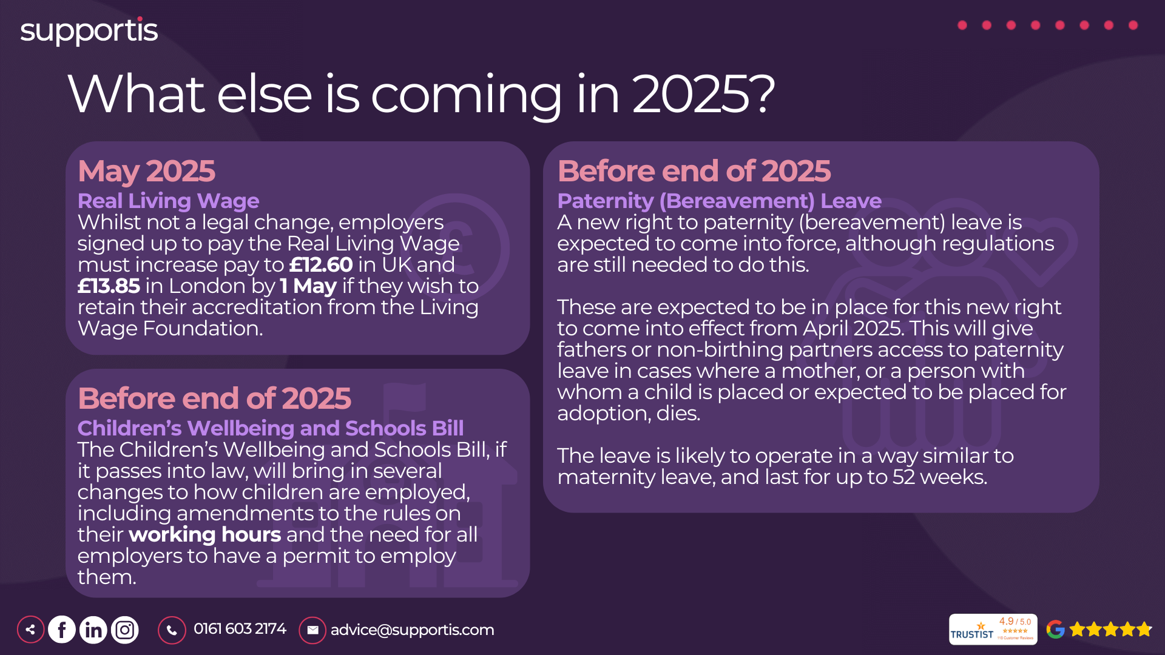
Notes:
Real Living Wage (May 2025): Not a Legal Change: "It's important to note that the Real Living Wage is not a legal requirement. It's a voluntary commitment made by employers who choose to become accredited by the Living Wage Foundation."
New Rates: "However, for those businesses committed to the Real Living Wage, the rates will increase to £12.60 in the UK and £13.85 in London by May 1st, 2025. This requires businesses to plan for these pay increases to maintain their accreditation."
Business Implications: "This is primarily relevant for businesses that value ethical pay practices and wish to maintain their Living Wage Employer status. It will require adjustments to payroll budgets."
Paternity (Bereavement) Leave (Before end of 2025): New Right: "A new right to paternity (bereavement) leave is expected to come into force before the end of 2025, although the exact regulations are still pending. This will provide fathers or non-birthing partners with access to leave in cases where the mother or a person with whom a child is placed for adoption dies."
Likely Operation: "The leave is likely to operate similarly to maternity leave, lasting up to 52 weeks. This will require businesses to update their leave policies and procedures to include this new entitlement."
Impact on Businesses: "This will require sensitivity and understanding from HR and management when dealing with such situations. Clear policies and training will be needed to ensure compliance and support for affected employees."
Children's Wellbeing and Schools Bill (Before end of 2025): Potential Changes: "The Children's Wellbeing and Schools Bill, if passed into law, will bring several changes to how children are employed. This includes potential amendments to working hours regulations and a new requirement for all employers to have a permit to employ children, regardless of the child's age or working hours."
Impact on Businesses: "This will significantly impact businesses that employ children, particularly in sectors like retail, hospitality, and entertainment. Businesses will need to be aware of the changes to working hours and ensure they have the necessary permits in place."

Slide 23
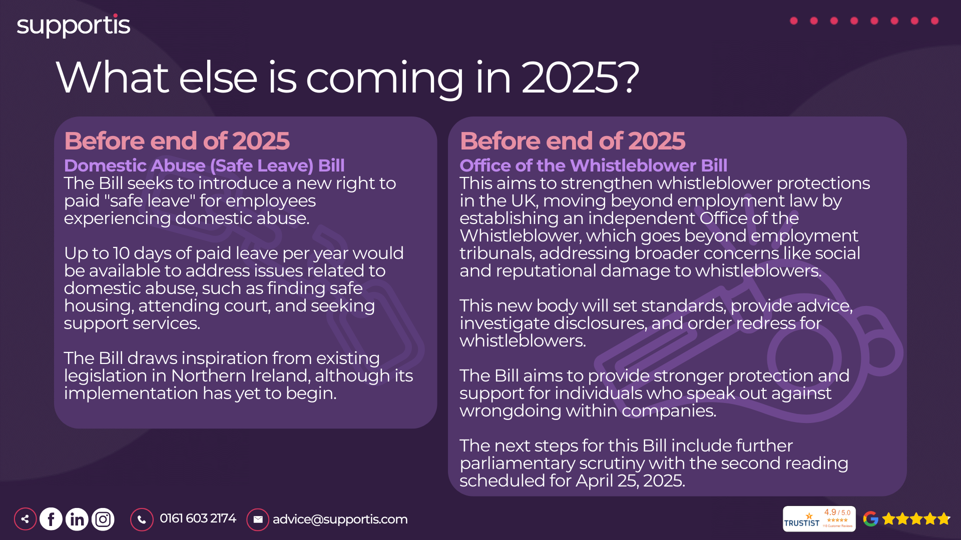
Notes:
Domestic Abuse (Safe Leave) Bill (Before end of 2025): New Right to Paid Leave: "This bill seeks to introduce a new right to paid 'safe leave' for employees experiencing domestic abuse. This is a significant step towards supporting employees in vulnerable situations."
Leave Entitlement: "The proposed entitlement is up to 10 days of paid leave per year. This leave is intended to allow employees to address various issues related to domestic abuse, such as finding safe housing, attending court appointments, and seeking support services."
Business Implications: "This will require businesses to develop and implement specific policies and procedures for handling requests for safe leave. HR and managers will need training on how to approach these situations with sensitivity and confidentiality. It's also important to consider the potential impact on workforce planning and ensure adequate coverage during employee absences."
Inspiration from Northern Ireland: "The bill draws inspiration from existing legislation in Northern Ireland, although its implementation there has yet to begin. This means we can look to their experience for insights, but we should also be prepared for potential differences in implementation in Great Britain."
Office of the Whistleblower Bill (Before end of 2025): Strengthening Whistleblower Protection: "This bill aims to significantly strengthen whistleblower protections in the UK. It proposes establishing an independent Office of the Whistleblower, which represents a major shift in how whistleblowing is handled."
Beyond Employment Law: "The new office will go beyond the scope of employment tribunals, addressing broader concerns such as social and reputational damage to whistleblowers. This suggests a more holistic approach to protecting individuals who speak out against wrongdoing."
Powers and Responsibilities: "The Office of the Whistleblower will have the power to set standards for whistleblowing procedures, provide advice to whistleblowers and organizations, investigate disclosures, and order redress for individuals who have suffered detriment as a result of whistleblowing."
Business Implications: "Businesses will need to ensure their internal whistleblowing procedures are robust and compliant with the standards set by the new office. They should also be prepared for potential investigations and be aware of the broader protections offered to whistleblowers."
Parliamentary Scrutiny: "The bill is currently undergoing parliamentary scrutiny, with the second reading scheduled for April 25, 2025. This means the bill is progressing, but it's still subject to change. We need to monitor its progress and be prepared to adapt our procedures accordingly."

Slide 24
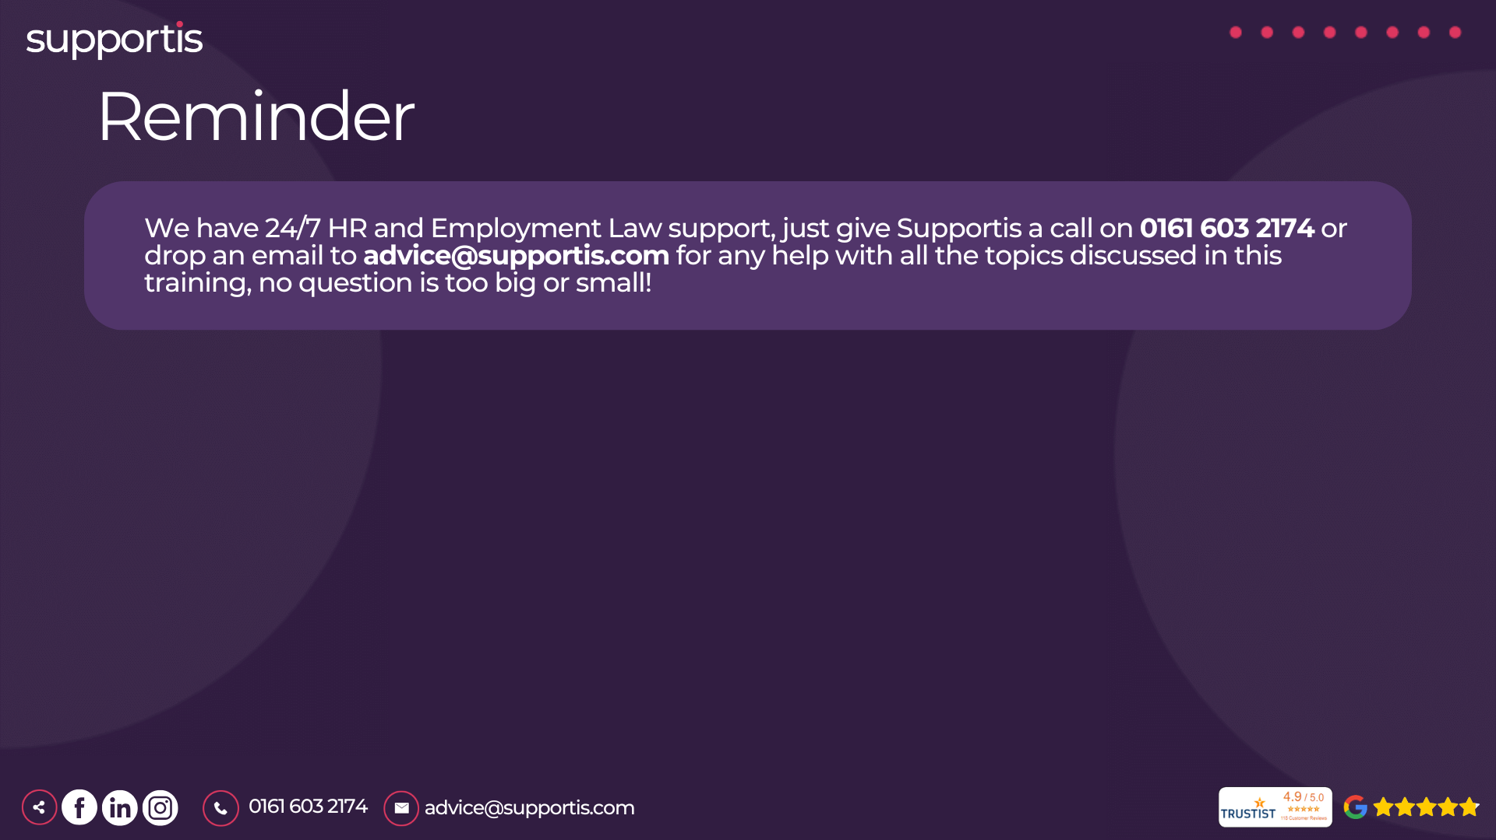
Notes:
We've covered a lot of ground today, and it's understandable if you have questions or need further guidance as these changes come into effect. Remember, navigating employment law can be complex, but you're not alone.
As part of our agreement with Supportis, we have access to their expert HR and Employment Law support, 24 hours a day, 7 days a week.
For any HR-related query, big or small, just give Supportis a call at 0161 603 2174 or drop them an email at advice@supportis.com.
They can assist us with any of the topics we've discussed today – from updating contracts and handbooks to navigating tricky situations with dismissals, leave requests, and more. Don't hesitate to use this valuable resource. It's there to help us ensure we're always compliant and handling things the right way. And importantly, running things by Supportis first ensures we're definitely above board, compliant, and doing everything correctly.

